Slide 1
Advocacy Through Social Media

Slide 3
Why does
it matter?

Slide 4
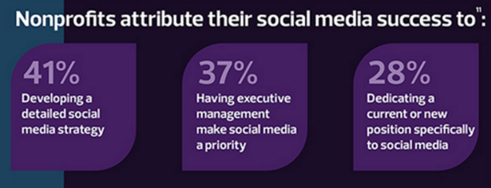

Slide 5
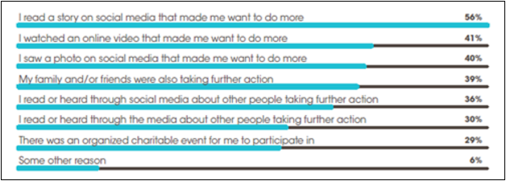

Slide 6
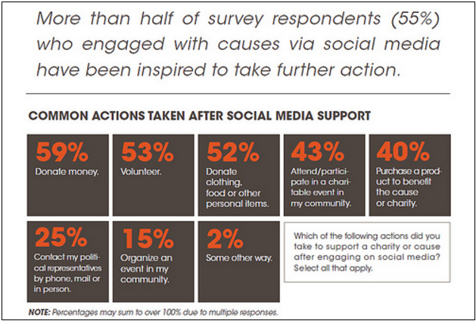

Slide 7
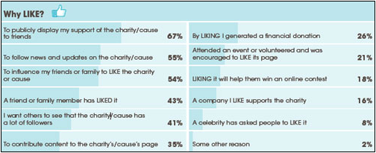

Slide 9
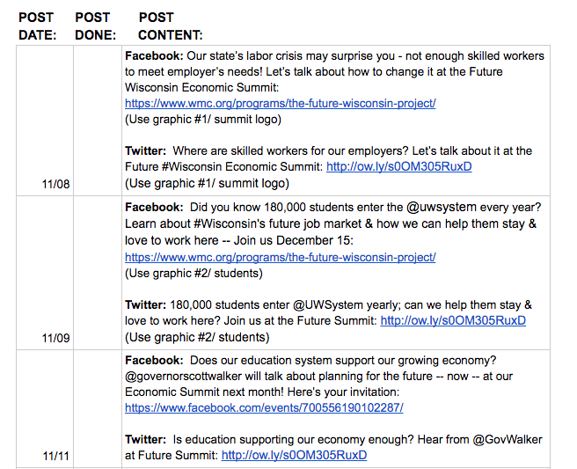
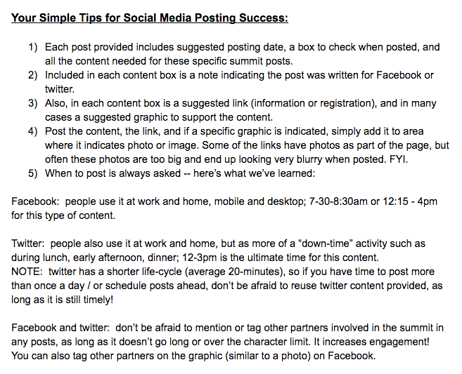
Equipping your board, sponsors and partners:
Equipping your board, sponsors and partners to advocate

Slide 11
Best Practices & Hot Tips

